Slide 1
House Price: Advanced Regression Techniques
Group 4
Darryl Connelly
Yawavi Koudjonou
Marius Clark
KC Oh

Slide 2

Housing Price Prediction of “Melbourne”, Australia using Regression Algorithms
The project may help contractors or buyer to price new houses and estimate demands.
About The Dataset
This dataset contains house sale prices for “Melbourne”, Australia. It includes homes sold between “2017 September and 2019 September”.
https://www.kaggle.com/anthonypino/melbourne-housing-market/version/27?select=Melbourne_housing_FULL.csv

Slide 3
Methodology
Data
Collection
Pre-Processing
Data Analysis
Application of Algorithms
Evaluating the Models

Slide 4
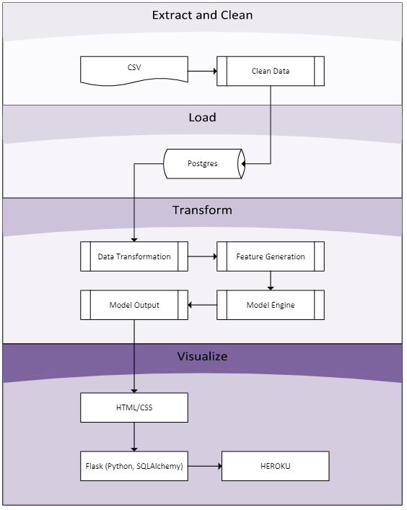
Architectural Diagram

Slide 5
Data Pre-Processing
Import Data
Data cleaning
Identifying outliers
Data Visualization
Data Conversion

Slide 6
Technologies
Jupyter Notebook
Python/Pandas/Numpy/Seaborn
MatPlotlib
SciPy
Postgres SQL/ SQLAchemy
Scikit-learn
Flask
HTML/CSS
Heroku

Slide 7
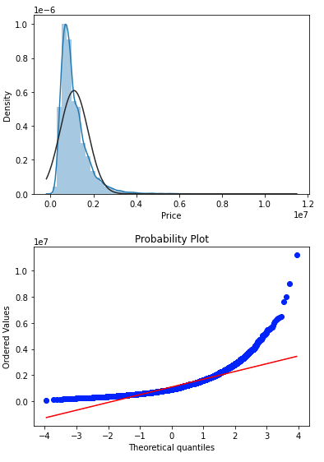
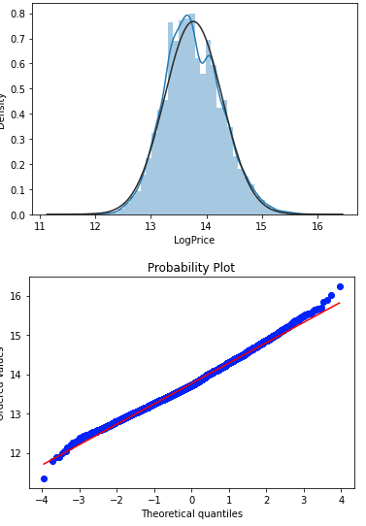
Normality Check
histogram and probability plot with normally distributed
histogram and probability plot after transforming that with np.log()

Slide 8
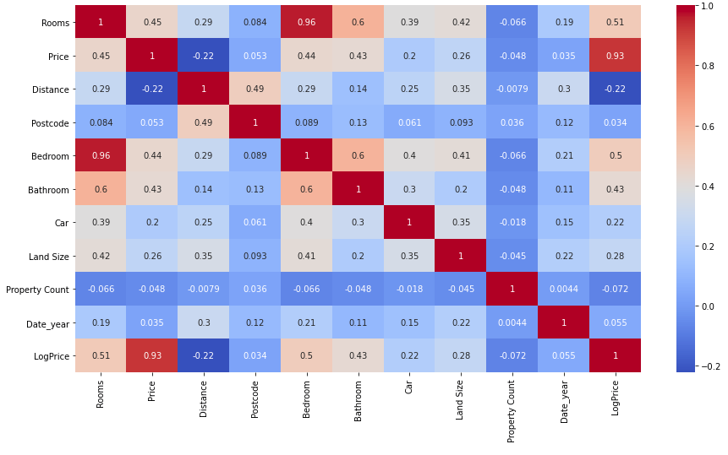
Heatmap
Based on the heatmap, dropping of some columns are needed. [Postcode, year, Land Size, Property count]
Heatmap

Slide 9
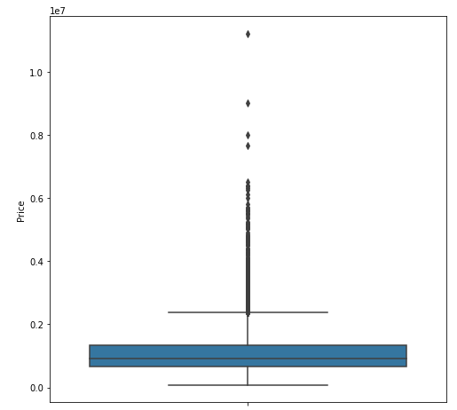
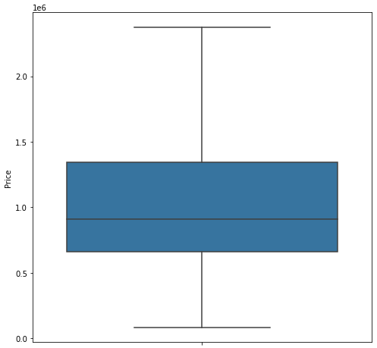
Outliers
With outlier Price Boxplot
Without outlier Price Boxplot

Slide 10
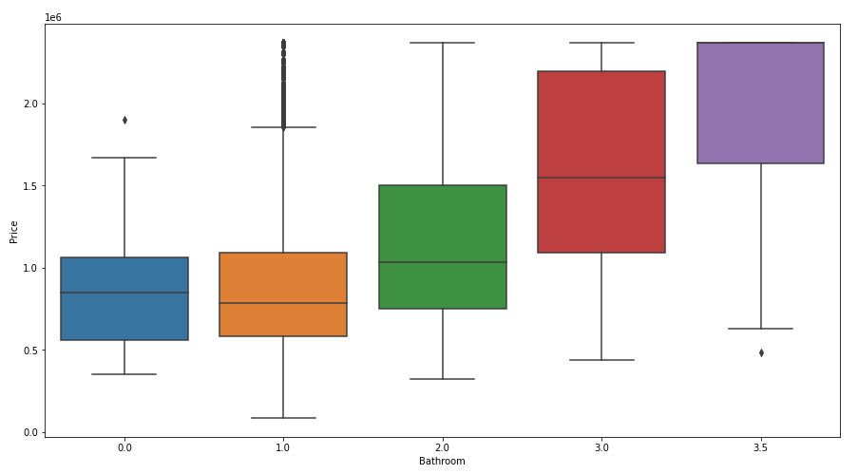
Data Visualization
Relationships
Bathroom VS Price

Slide 11
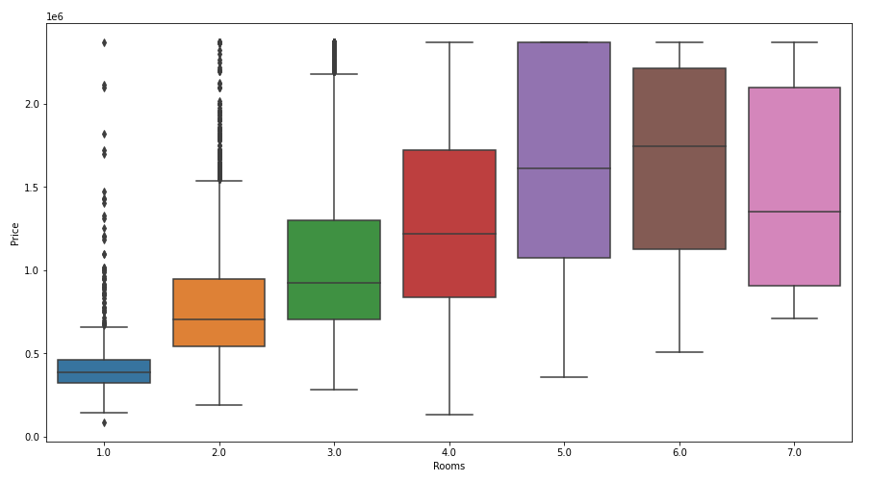
Data Visualization
Relationships
Rooms VS Price

Slide 12
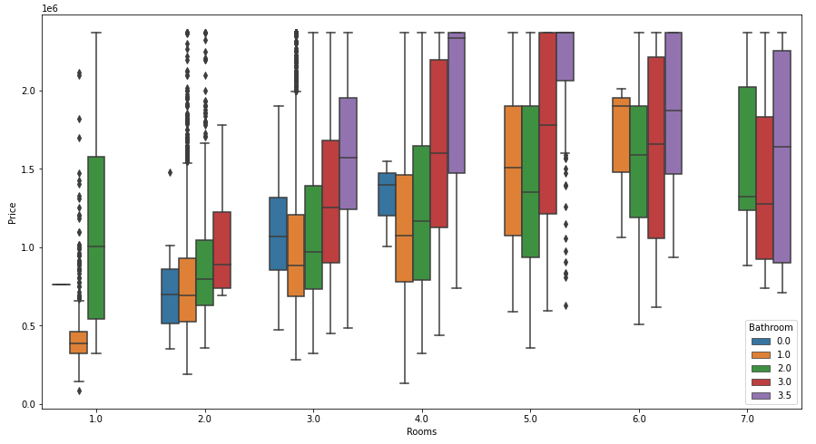
Data Visualization
Relationships
Rooms, Bathroom VS Price

Slide 13
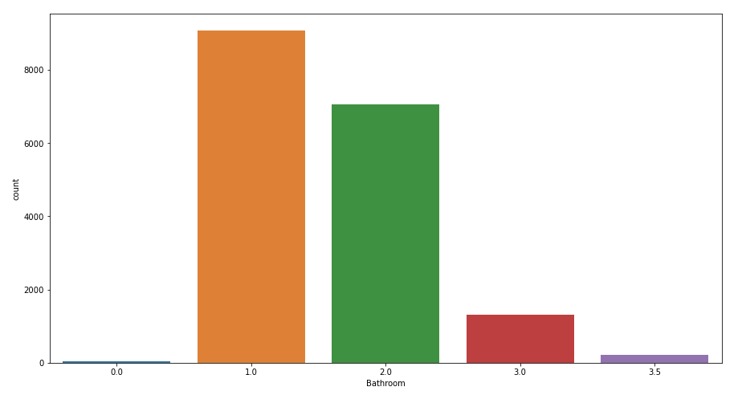
Data Visualization
Relationships
Countplots Bathroom

Slide 14
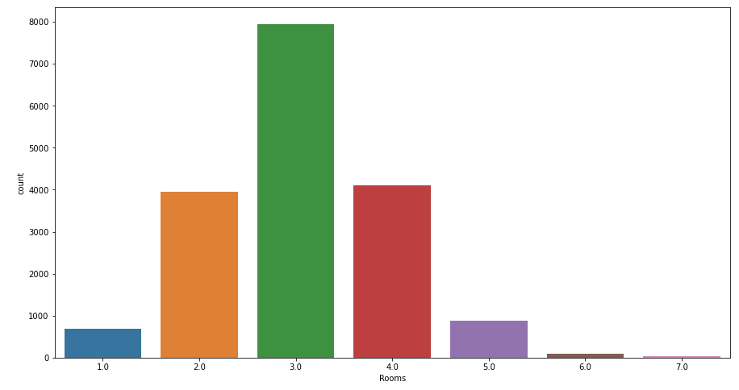
Data Visualization
Relationships
CountPlots Rooms

Slide 15
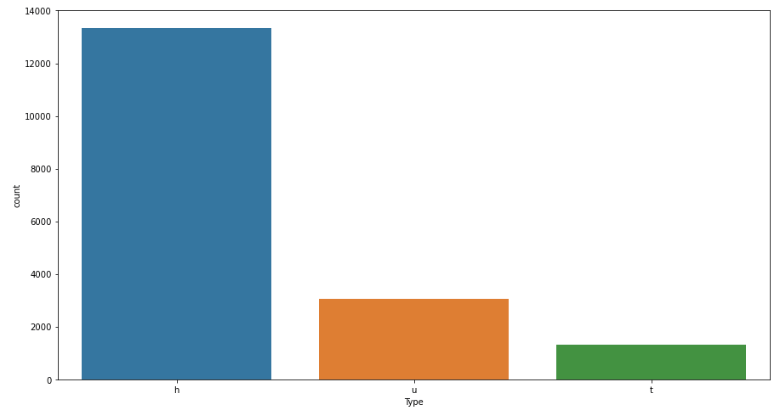
Data Visualization
Relationships
CountPlots Type (h : House,villa,cottage,semi,terrace) (u:unit,duplex) (t:townhouse)

Slide 16
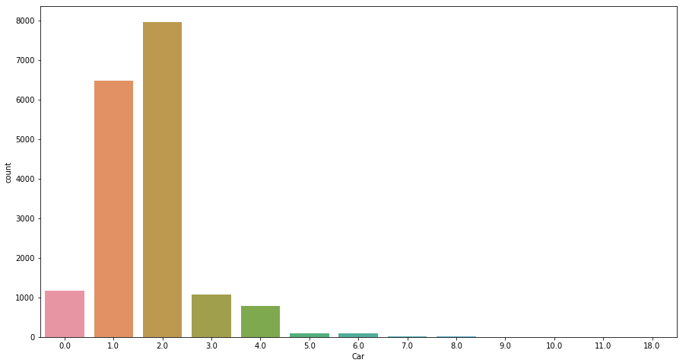
Data Visualization
Relationships
CountPlots car

Slide 17
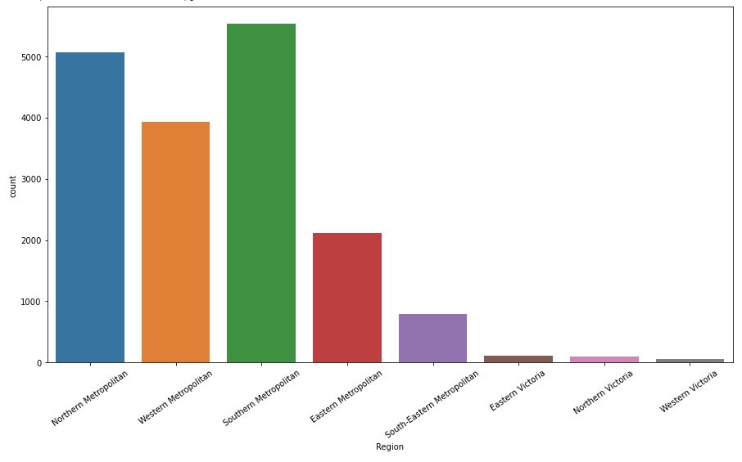
Data Visualization
Relationships
CountPlots Region

Slide 18
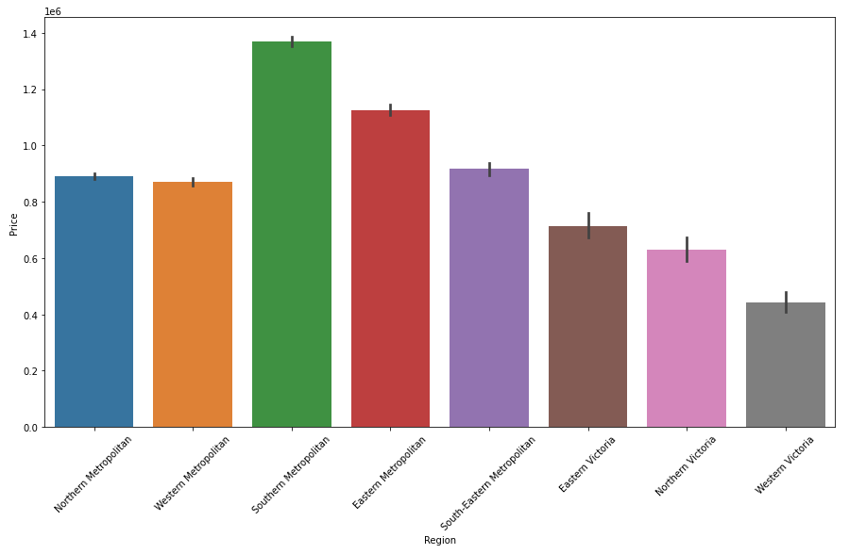
Data Visualization
Relationships
CountPlots Region vs Price

Slide 19
Model Analysis
Linear Regression Model
Random Forests Model
Decision Tree Model
Randomized Search CV Model
Support vector Regressor
Lasso Model
Ridge Model

Slide 20
Model Tested
 | train score(R2) | test score
Linear Regression | 0.476343 | 0.461641
Random Forest | 0.297033 | 0.055643
Decision Tree | 0.893777 | 0.712371
Randomized Search CV model | -128442183255.74026 | -126698883394.39828
Support Vector Regressor | -0.072771 | -0.073329
Lasso Model | 0.4763433 | 0.4616413
Ridge Model | -0.297450 | -0.300917

Slide 21
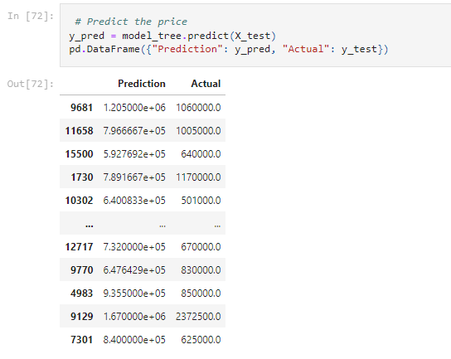
Decision Tree Model
Decision Tree Model Was Selected For Prediction Among All the Reviewed Models
 | train score(R2) | test score
Decision Tree | 0.893777 | 0.712371

Slide 22
Thank You. That's All.

